Slide 1
How to Get Noticed on Amazon
Yes It Is Possible and Yes You Can Do This…

Slide 2
What Will We Cover Today?
How to make your page look great
How to make your book easier to find
How to get more reviews (& why)
Marketing programs available
Why and How to improve your author page

Slide 3
How Your Page Looks Is SO Important!

Slide 4
Cover
Search Inside
Description with lots of white space and bullet points
Author Bio
Price Competitive with Page Count
Reviews
Professional Publisher Name

Slide 5
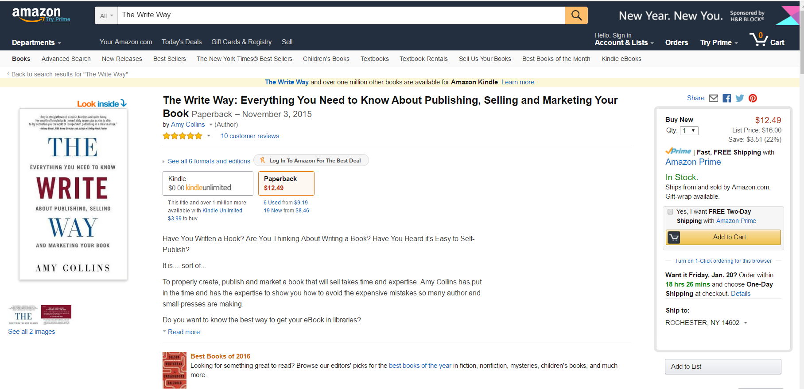

Slide 6
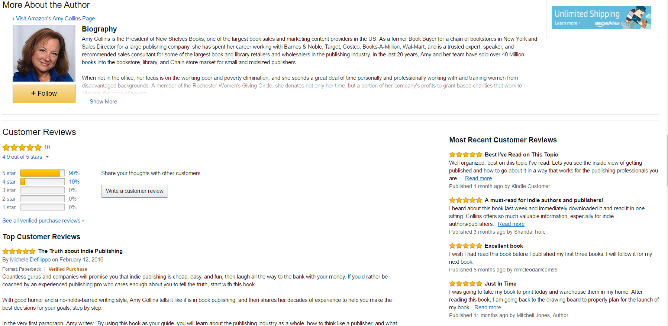

Slide 7
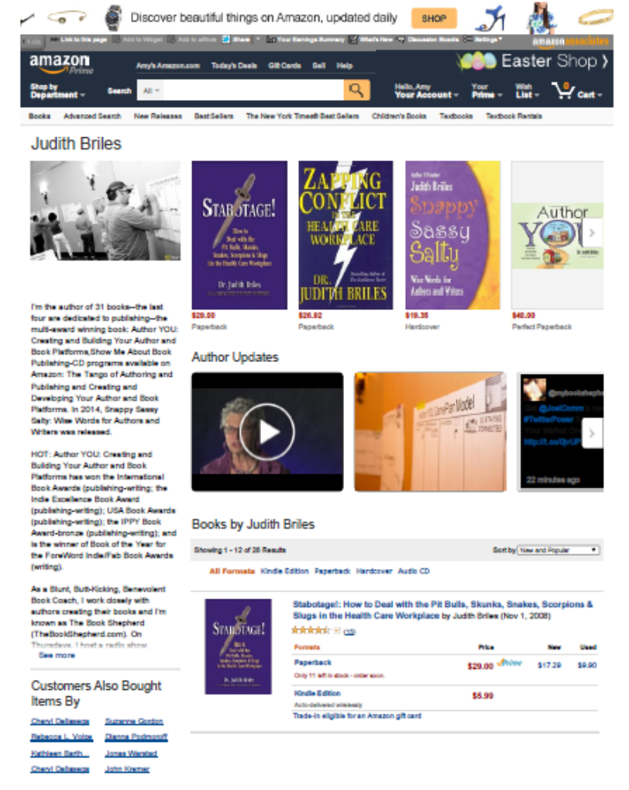
Author Central

Slide 8
Questions?

Slide 9
Make Your Book Easier to Find

Slide 10
Ranking Does Not Matter As Much as Searchability.

Slide 11
Make Your Book More Discoverable With Keywords
Be accurate, be precise, combine keywords in the most logical order
Use up to seven keywords or short phrases. You get 7.
Think like your customer. Think about how you would search for your book if you were a customer, and ask others to suggest keywords they'd search on. Useful keyword types ● Setting (Colonial America) ● Character types (single dad, veteran) ● Character roles (strong female lead) ● Plot themes (coming of age, forgiveness) ● Story tone (dystopian, feel-good)

Slide 12
Other Ways Your Book Can Be Found
Shopping and Wish Lists http://www.amazon.com/gp/registry/wishlist/
Links to other books
85+ Reviews by AmazonCustomers

Slide 13
Editorial Reviews? Verified Reviews? Vine Reviews? Other?

Slide 14
Marketing Opportunities through AMS www.ams.amazon.com

Slide 15
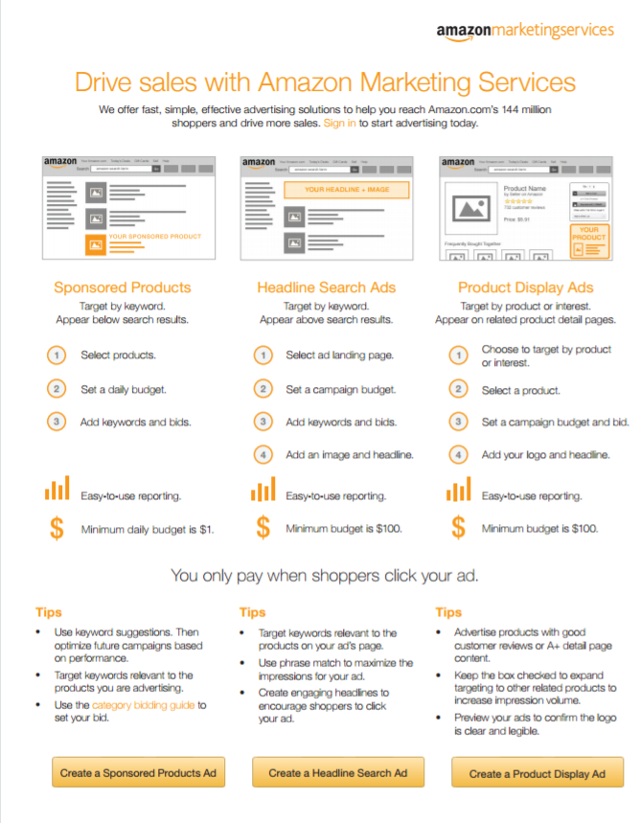

Slide 16
Questions?

Slide 17
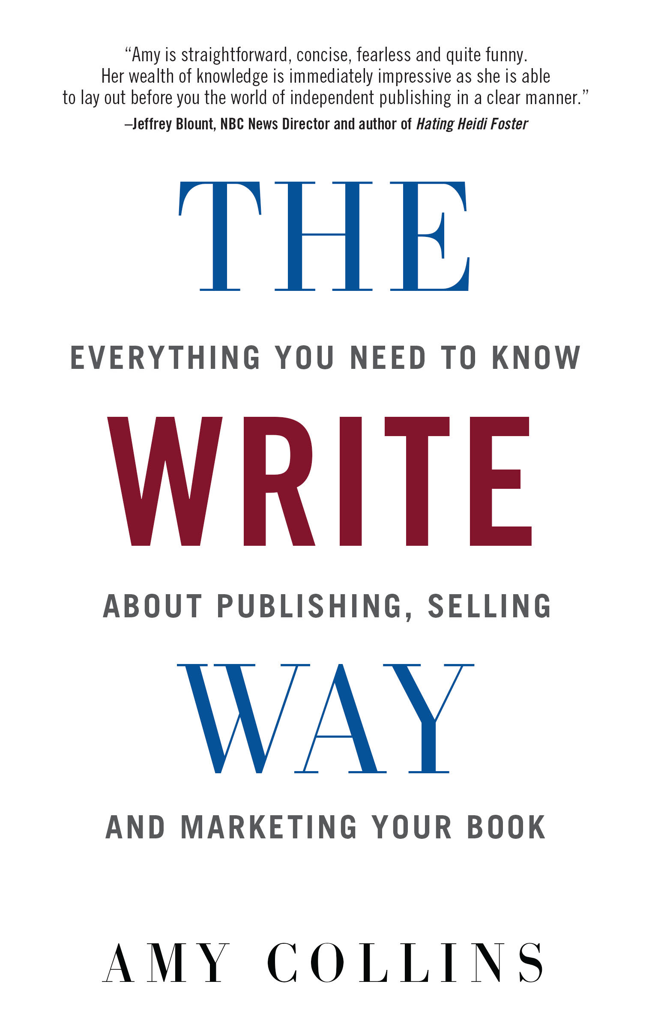
Please get in touch if you have any
questions!
Amy Collins
New Shelves Books
595 Blossom Rd Suite 301A
Rochester, NY 14610
518.261.1300 Phone
NewShelvesBooks Skype
amy@newshelves.com Email
www.newshelvesdistribution.com Website
http://twitter.com/NewShelvesBooks Twitter
https://www.facebook.com/newshelvesdistribution Facebook

